Slide 1
Lecture 4
Dynamic Memory Allocation

Slide 2
Main Points
Difference between dynamic and static memory allocation
malloc, calloc, and free functions
Examples

Slide 3
Static vs Dynamic Memory Allocation
When declaring an Array, a structure …, the programmer has to guess the largest size hence memory space is reserved till the program is over
Especially, for arrays, the Max_Size has to be defined in advance.
“What if the array is not completely used?” - “What if the element of an array is deleted?” : Space is still there  Waste of memory
C does not have this limitation because of Dynamic Memory Allocation
DMA is meant to make optimal use of memory.
Allocate and de-allocate memory as needed.

Slide 4
Static vs Dynamic Memory Allocation (Cont..)
SMA requires that the number of bytes reserved for a variable cannot be changed during run time.
Exp: char name[20], 20 bytes are reserved for the array through the whole program execution time.
DMA uses predefined functions to allocate & release memory for data while the program is running.
 SMA uses declarations & definitions
 DMA uses predefined functions

Slide 5
Memory Management Functions malloc / calloc / free
You can “dynamically” control the memory as you need it:
If you need memory  you ask for it.
Once you do not need it any more  you free it.
Two C functions for allocating memory:
malloc (Memory Allocation)
calloc (Contiguous Memory Allocation)
One C function to release/free the memory:
free
The three functions are defined in <stdlib.h>

Slide 6
malloc Function
Used to allocate a single memory block of any built-in or user-defined type
Syntax:
malloc (sizeof (data_type))
Remember sizeof() returns the number of bytes need for the declared data type
Exp:
ptr_1 = (char *) malloc ( sizeof (char));
Allocates exactly enough space to hold one type char value and returns a “pointer” to the address of the block allocated. The returned pointer is of type void*
Don’t forget to cast! Casting???
ptr_2 = (stud *) malloc ( sizeof (stud))
(stud is a structure)

Slide 7
Calloc Function
Used to allocate memory for arrays of elements of any built-in or user-defined type.
It takes two arguments:
The number of elements in the array
The size of the data type of elements
Syntax:
calloc ( n, sizeof( data_type))
calloc should be cast too as with malloc
Exp:
array_1 = (char *) calloc(20, sizeof ( char))
array_2 = (stud *) calloc(100, sizeof (stud))

Slide 8
Free Function
When memory allocated by malloc & calloc are no longer needed, they should be freed using the free function.
Syntax: free (name of the pointer)
Tip:
If memory space is not available, malloc & calloc return a NULL pointer.
Useful:
if (ptr = (type *)malloc(sizeof(type)) == NULL) printf(“Could not allocate memory);

Slide 9
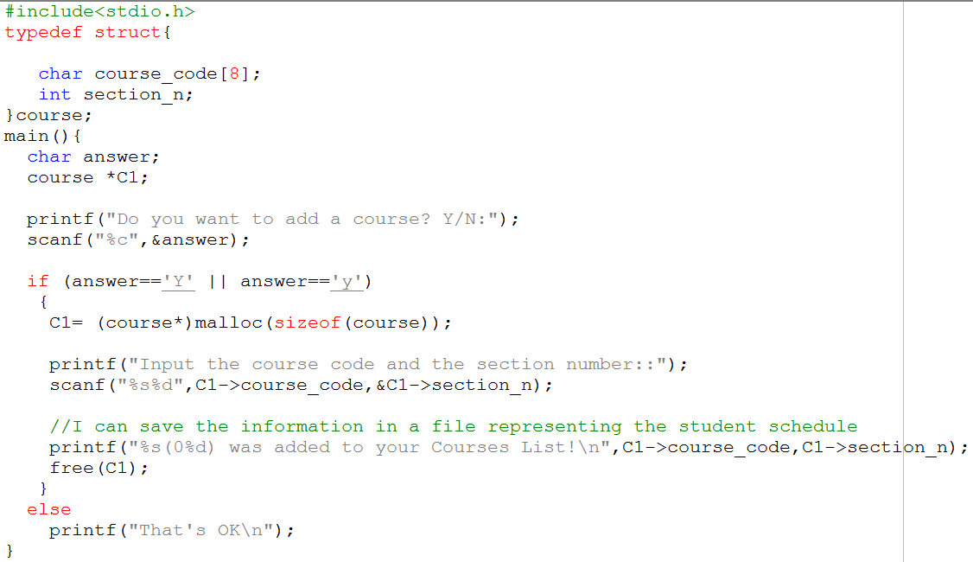
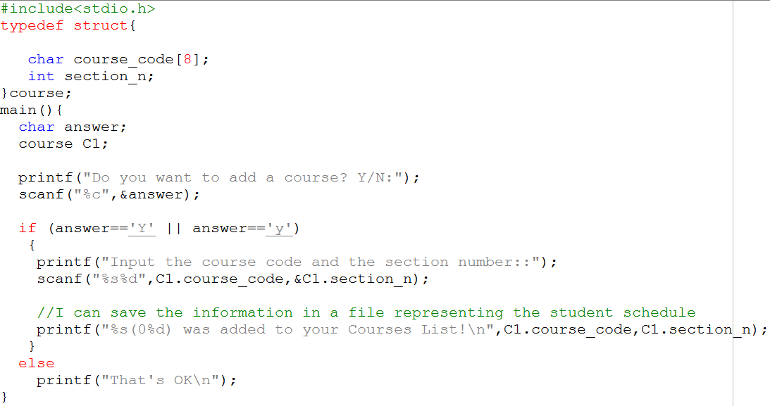
What do you think of these codes?

Slide 10
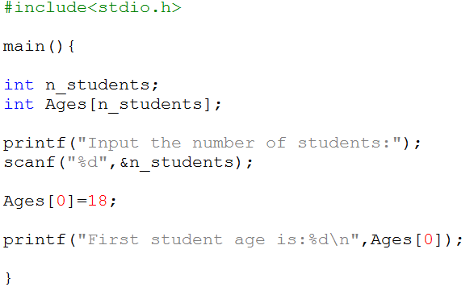
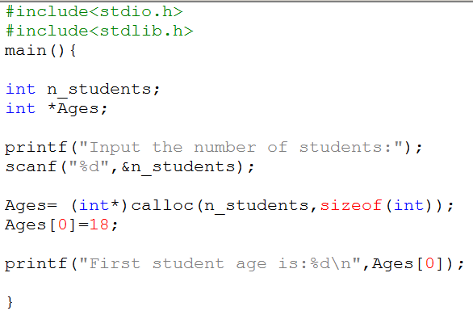
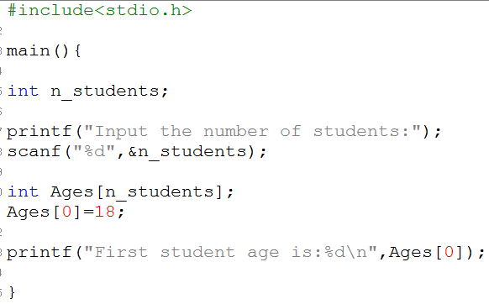
What do you think of these codes?

Slide 11
Example
Refer to the code in the next slide

Slide 12
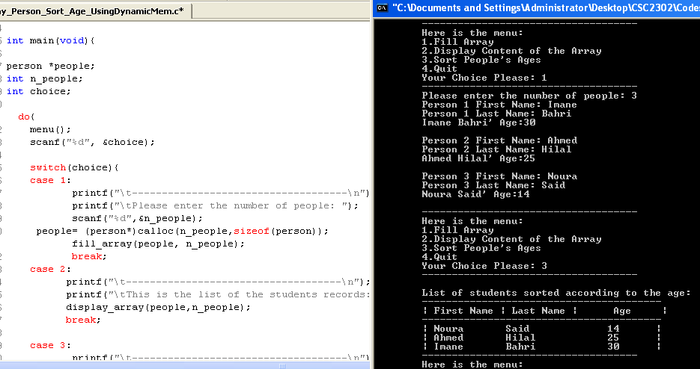
Illustration

Slide 13
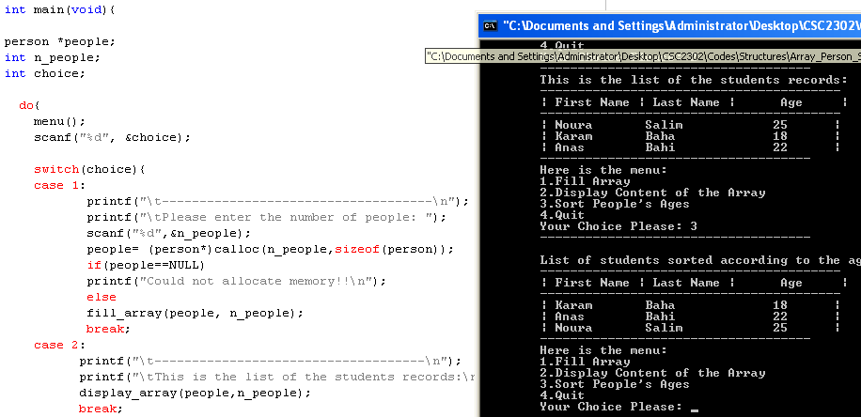
Same code: include memory checking

